Slide 1
Ruby Training: Class Objects
Matthew Eakin, Manager
Managed Testing Practice
Sogeti, USA
Matthew.Eakin@us.sogeti.com

Slide 2
Agenda
Note: this presentation is the 3rd of a three part series (Variables, Methods, Class Objects). The examples are a continuation from the Variables and Methods presentations
Creating a Class Object in code
Using a Class Object
Class Methods
Class Variables
attr_accessor
Creating a Class Object in a file

Slide 3
Defining a class
Always starts with the keyword “class” followed by the name of the class
Name should always be in initial capitals
Syntax:
class <Name>
end
Add this code to the TOP of the code you plan to use it in
As with methods, class objects need to be initialized before they can be called
class Person
end
def hello_neighbor(neighbor)
puts "hello #{neighbor} my name is #{$my_name}"
end
#MY_NAME = "Matthew"
$my_name = "Matthew Eakin"

Slide 4
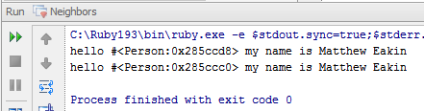
Invoking the class
As with most objects in Ruby, to create a new instance of a class object you can use the “new” method
Syntax:
Object.new
Update the code as follows and run Will get these results:
@my_name = "Matthew Eakin"
neighbor_dad = Person.new
neighbor_mom = Person.new
hello_neighbor(neighbor_dad)
hello_neighbor(neighbor_mom)
Results are not quite
##Note that a lot of code has been removed what we were hoping for

Slide 5
Class Methods
Methods in class object work just like they do anywhere else
Syntax:
def <name>(parameters)
<code>
end
“initialize” method is a special type of method which is called at the time of the class creation
It is optional
Examples:
class Car
def initialize(type)
end
end

Slide 6
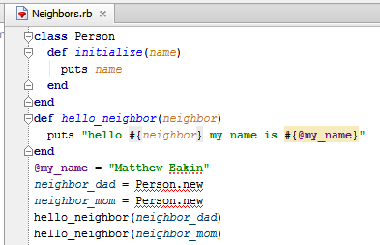
Adding a Parameter to a Class Method
Ruby allows you to pass parameters to class methods just as you would to any other method
Add the following code to the Person class:
class Person
def initialize(name)
puts name
end
end
Did anything break? Of course it did…

Slide 7
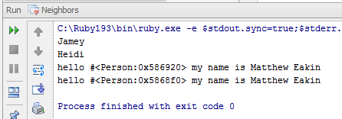
Invoking the Initialize method
Every time you call the “new” method you are calling the “initialize” method
This is where we need to pass our neighbor’s name
Update your code as follows and run Will get these results
@my_name = "Matthew Eakin"
neighbor_dad = Person.new("Jamey")
neighbor_mom = Person.new("Heidi")
hello_neighbor(neighbor_dad)
hello_neighbor(neighbor_mom)

Slide 8

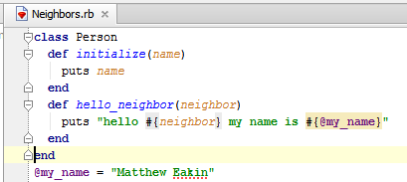
Adding Methods to Classes
You can add methods to class object just as you would anywhere else
Earlier we created a hello_neighbor method in the Step Definition file. Now I would like to say hello to each of my neighbors. To keep the code simple I am going to move the hello_neighbor method…
…to the Person class:

Slide 9
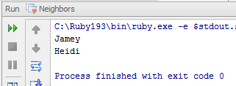
Ruby Constants in a Class Object
Ruby allows you to put Constants in Class Objects
They function exactly the same as anywhere else
Update your code and run Will get these results
class Person
MY_NAME = "Matthew Eakin"
def initialize(name)
puts name
end
def hello_neighbor(neighbor)
puts "hello #{neighbor} my name is #{MY_NAME}"
end
end
neighbor_dad = Person.new("Jamey")
neighbor_mom = Person.new("Heidi")
#hello_neighbor(neighbor_dad)
#hello_neighbor(neighbor_mom)

Slide 10
Class Variables
Class variables stay alive for the life of the class
They need to be initialized when the class is initialized
Update the Person class object as follows:
class Person
MY_NAME = "Matthew Eakin"
@@neighbor_name = ''
def initialize(name)
@@neighbor_name = name
end
Remove the “neighbor” parameter and add the class variable to the greet_neighbor method:
def hello_neighbor
puts "hello #{@@neighbor_name} my name is #{MY_NAME}"
end

Slide 11
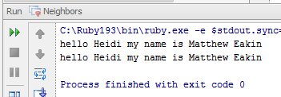
Calling Methods within a class
Recall that the sytax to call a method is:
Object.method
To call the greet_neighbor method in the Person we need to update our calls as follows:
neighbor_dad = Person.new("Jamey")
neighbor_mom = Person.new("Heidi")
#hello_neighbor(neighbor_dad)
#hello_neighbor(neighbor_mom)
neighbor_dad.hello_neighbor
neighbor_mom.hello_neighbor
Run the Project and you should get the following results:
Do you see anything wrong?

Slide 12
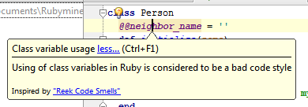
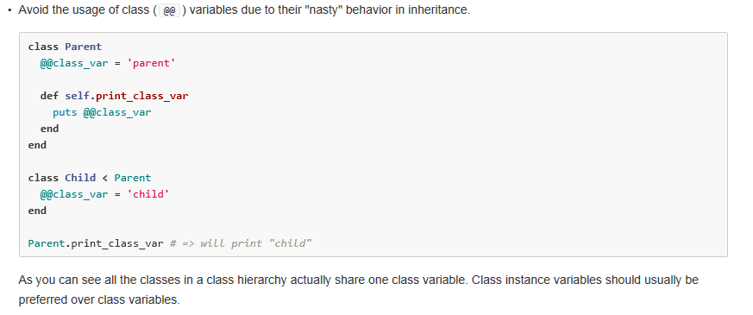
How does Ruby feel about Class Variables
Take a look at your Person class. RubyMine is giving you the following message:
Don’t following the link, it’s broken. Instead, go to the Ruby Style Guide
(https://github.com/bbatsov/ruby-style-guide#classes)

Slide 13
attr_accessor
“attr_accessor” – acts like the old “get” and “set” methods of prior programming languages
Syntax:
attr_accessor :<variable_name>, :<another_variable>
To access an attr_accessor variable from within the class object you use the “@” designation (instance variables inside the class)
To access an attr_accessor variable from outside the class object you use the “Object.variable” designation (similar to calling a method)

Slide 14
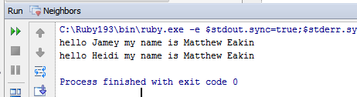
Using attr_accessor
Let’s refactor our Person class object code like this:
class Person
MY_NAME = "Matthew Eakin"
attr_accessor :neighbor_name
def initialize(name)
@neighbor_name = name
end
def hello_neighbor
puts "hello #{@neighbor_name} my name is #{MY_NAME}"
end
end
Run the Project will get these results:

Slide 15
Inheritance (subclassing)
Ruby enables you to create a new class whose behavior is based on, but modified from, the behavior of an existing class
The “subclass” extends (or inherits) the “superclass”
“Superclasses” can have multiple “subclasses”. But each “subclass” can have only one “superclass”
Use the “<“ (less than) symbol to inherit
Sytax:
class <Subclass> < <SuperClass>
end
Example:
class MainPage < HeaderSection
end

Slide 16
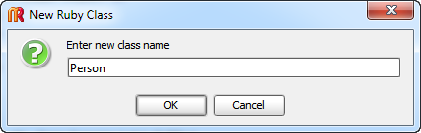
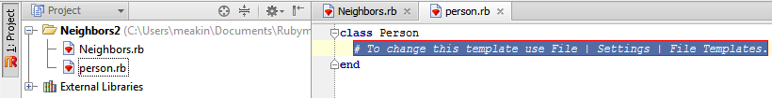
Creating a Class file
To create a class file right-click on the Project or directory you wish to add it to, goto New -> Ruby Class
You will get the New Ruby Class pop-up
Enter new class name: Person
Remember, Ruby class names MUST start with a 1st letter in CAPS
It is fine to use multiple words (i.e. NewNeighbor)
Class name will be as you write it
Class file name will be all lower case with “_” separators
i.e. new_neighbor.rb

Slide 17
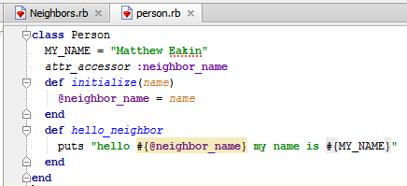
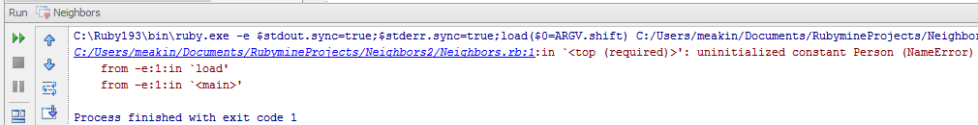
Finishing the Project
Cut and paste the entire Person class from the Step Definitions file into the new Person class file
Run the feature and you should get…

Slide 18
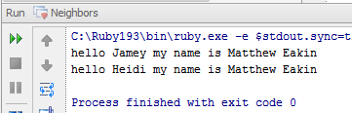
Requiring files
Now that the class object code is no longer in the same file as the rest of our code, it doesn’t know where it is
We need to “require” the new class file
Update code as follows and run Will get the following results:
require './person'
neighbor_dad = Person.new("Jamey")
neighbor_mom = Person.new("Heidi")
#hello_neighbor(neighbor_dad)
#hello_neighbor(neighbor_mom)
neighbor_dad.hello_neighbor
neighbor_mom.hello_neighbor

Slide 19
Thank you

